Slide 1

CORPORATE INSURANCE VS INDIVIDUAL INSURANCE
Insurance Combat
Actuarial Science

Slide 2
OBJECTIVES:
01
WHICH INSURANCE (Corporate or Individual)
IS BETTER?
02
INSURANCE TRENDS (which insurance is most preferred by people)
03
COVID-19 ANALYSIS (Change of number of type of insurance post covid-19)
Notes:
Highlighting topic; because people don’t understand the importance of individual insurance.

Slide 3



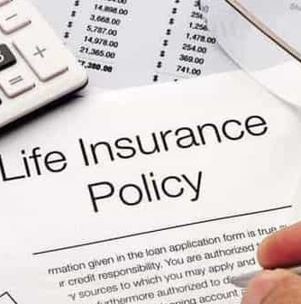
DEFINITIONS:
INSURANCE
TERM INSURANCE
LIFE INSURANCE
Insurance is a means of protection from financial loss. It is a form of risk management, primarily used to hedge against the risk of a contingent or uncertain loss.
Term insurance plan only provides death benefit in case of demise of the insured within the term period.
Life insurance policy offers both death and maturity benefit to the insured

Slide 4


CORPORATE INSURANCE
Corporate Insurance is also provided in India. It provides coverage to a group of people belonging to a common community (typically as employees of a company). These plans are generally uniform in nature, offering the same benefits to all employees or members of the group.
INDIVIDUAL INSURANCE
Insurance you buy on your own i.e. not through an employer or association is called individual insurance.

Slide 5
DEFINITIONS-
PREMIUM - Premium is an amount paid periodically to the insurer by the insured for covering his risk.
CLAIM - An insurance claim is a formal request by a policyholder to an insurance company for coverage or compensation for a covered loss or policy event.
INSURANCE COVER - Insurance coverage is the amount of risk or liability that is covered for an individual or entity by way of insurance services.
MATURITY BENEFIT- Maturity benefits indicate the sum received by a policyholder or his/her beneficiaries when a policy matures.
ASSURANCE- Assurance refers to financial coverage that provides remuneration for an event that is certain to happen. Unlike insurance, which covers hazards over a specific policy term, assurance is permanent coverage over extended periods, often up to the insured’s death.
ENDORSEMENT- An insurance endorsement, also called a rider, is a change to your insurance policy that adjusts your coverage.

Slide 6
DATA PRE-PROCESSING
AND
REPRESENTATION

Slide 7
DATA PRE-PROCESSING:
1. Primary data collection through a questionnaire (Sample size=100).
2. Tabulation of data.
Tabulation
In tabulation, we convert the raw data into tables so that it is easier to clean the data.
3. Data cleaning
Data cleaning is a step after collection and tabulation of data.
It means to remove empty rows or columns so that the data can be further processed and used for analyzing and further coming to a conclusion.
4. Data Representation.
We’re representing the data in the form of bar charts and histograms.
Notes:
Data representation and exploratory data analysis.

Slide 8
EDA (Corporate Insurance):
1. The pie chart represents the number of males and females in the data set.
The number of males who’ve corporate insurance is 51.
The number of females who’ve corporate insurance is 49.
2. The bar chart represents the salary of males and females in the data set.
The highest number of people have salary of Rs 2,75,000
Less than 5 people have their salary as
Rs 2,50,000.

Slide 9
EDA (Individual Insurance):
1. The pie chart represents the number of males and females in the data set.
The number of males who’ve individual insurance is 21 .
The number of females who’ve individual insurance is 19.
2. The bar chart represents the salary of males and females in the data set.
The highest number of people have salary of Rs 1,50,000
The less than 5 people have their salary in the range Rs 2,00,000 and Rs 2,50,000.

Slide 10
FACTORS
WE TOOK
INTO CONSIDERATION

Slide 11
FACTORS:
GENDER
SALARY
AGE
MARITAL STATUS

Slide 12
STATISTICAL ANALYSIS

Slide 13

CHI SQUARE- INDEPENDENCE OF ATTRIBUTES:
A chi-square test for independence is applied when you have two categorical variables from a single population. It is used to determine whether there is a significant association between the two variables.
FORMULA : $\text{Χ}\text{2}\text{ = }\text{Σ}\text{ [ (}\text{O}\text{r}\text{,}\text{c}\text{ − }\text{Er}\text{,}\text{c}\text{)}\text{2}\text{ / }\text{Er}\text{,}\text{c}\text{ ]}$
A chi-square test for independence compares two variables in a contingency table to see if they are related. In a more general sense, it tests to see whether distributions of categorical variables differ from each another.
A very small chi square test statistic means that your observed data fits your expected data extremely well. In other words, there is a relationship.
A very large chi square test statistic means that the data does not fit very well. In other words, there isn’t a relationship.
Contingency table(E.g.)
 | Both | Corporate | Total
Male | 21 | 51 | 72
Female | 19 | 49 | 68
Total | 40 | 100 | 140

Slide 14
USING A CHI SQUARE TEST FOR INDEPENDENCE OF ATTRIBUTES:
To test the independence of the factors with the premium.
H0 (NULL HYPOTHESIS) : There is no association between the factors and the premium.
H1 (ALTERNATE HYPOTHESIS): There is an association between the factors and the premium.

Slide 15
INFERENCE (CORPORATE INS.):
Inference: The p-value < α =0.05, hence we reject null hypothesis. After looking at the p value, we see that only salary and job position influence premium.
We are taking the level of significance α as 0.05
Factors:
x1- Salary
x2- Job Position
x3- Gender
x4- Marital Status
Category | p- value | Is it associated?
Marital Status | 0.65 | No
Salary | 0.001 | Yes
Job Position | 0.001 | Yes

Slide 16
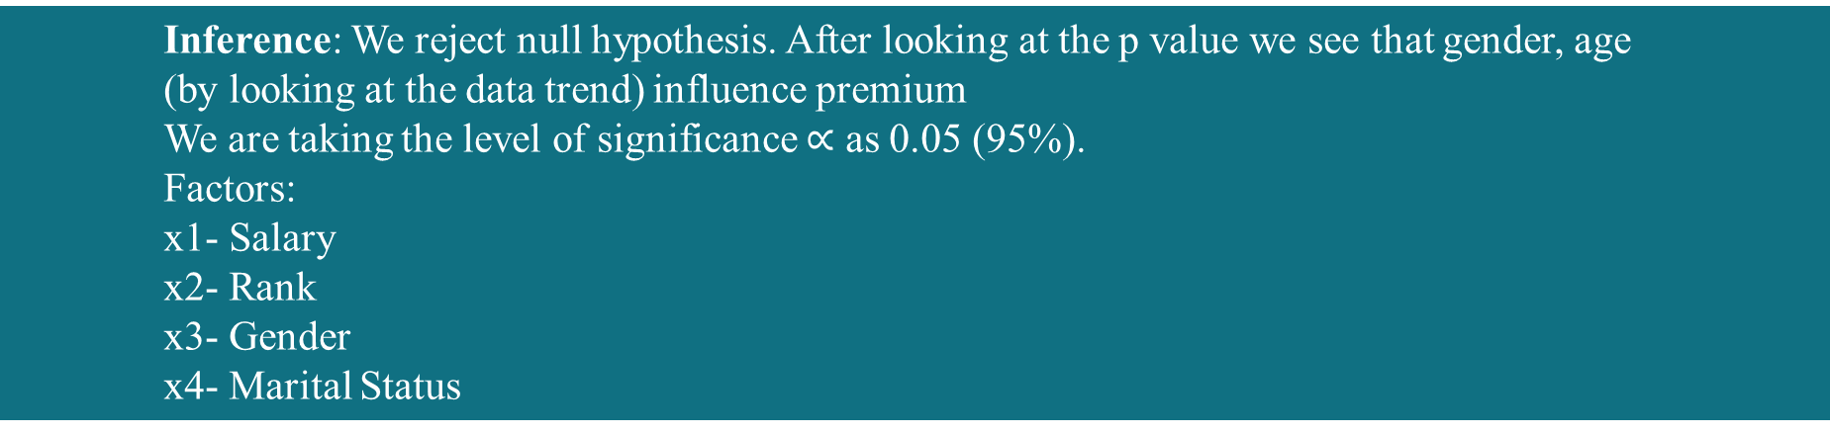
INFERENCE- INDIVIDUAL INSURANCE:
Inference: We reject null hypothesis. After looking at the p value we see that gender, age
(by looking at the data trend) influence premium
We are taking the level of significance $∝$ as 0.05 (95%).
Factors:
x1- Salary
x2- Rank
x3- Gender
x4- Marital Status
Category | P-value | Is it associated?
Salary | 0.28 | NO
Age | 0.042 | YES
Gender | 0.023 | YES
Marital status | 0.42 | NO

Slide 17
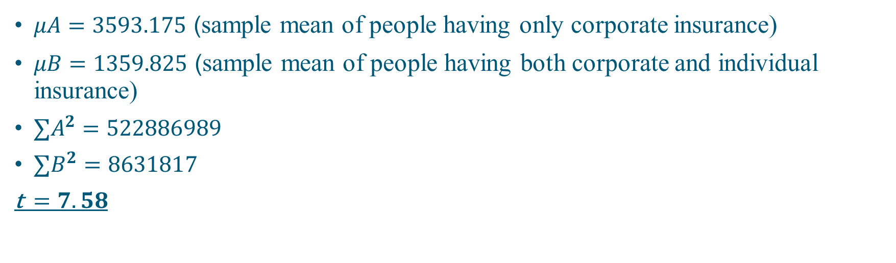

INDEPENDENT T-TEST:
The paired sample t-test, sometimes called the dependent sample t-test, is a statistical procedure used to determine whether the mean difference between two sets of observations is zero.
FORMULA : t$=\frac{μA−μB}{\sqrt{\frac{\left( ∑A^{2}−\frac{{∑A}^{2}}{nA}\right)+( ∑B^{2}−\frac{{∑B}^{2}}{nB})}{nA+nB−2}∗(\frac{1}{nA}+\frac{1}{nB})}}$
$μA=3593.175$ (sample mean of people having only corporate insurance)
$μB=1359.825$ (sample mean of people having both corporate and individual insurance)
$∑A^{2}=522886989$
$∑B^{2}=8631817$
t$=7.58$

Slide 18
Hypothesis and Inference:
NULL HYPOTHESIS (H0): There’s no difference between the sample means.
ALTERNATE HYPOTHESIS (H1): There’s a difference between the sample means.
Since t, i.e. 7.58 > 1.96, we reject the null hypothesis (H0) as the sample means are totally different.

Slide 19
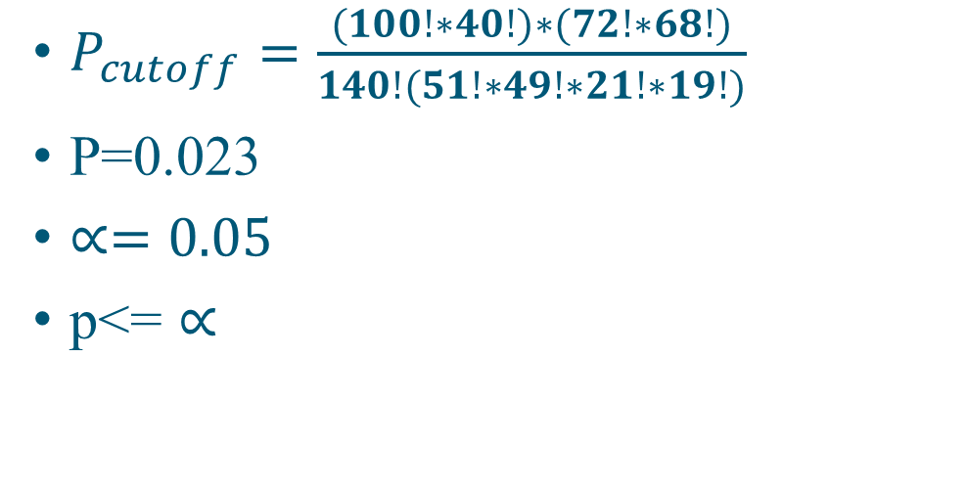

FISHER’S EXACT TEST:
Fisher's exact test is a statistical test used to determine if there are non-random associations between two categorical variables.
FORMULA : $P_{cutoff}=$ $\frac{(R_{1}! R_{2}! … R_{m}!)(C_{1}! C_{2}! ….. C_{n}!)}{N! ∏_{i j}a_{i j}!}$
$P_{cutoff}=$ $\frac{(100!∗40!)∗(72!∗68!)}{140!(51!∗49!∗21!∗19!)}$
P=0.023
$∝=0.05$
p<= $∝$
Contingency table
 | M | F | Total
C | 51 | 49 | 100
B | 21 | 19 | 40
Total | 72 | 68 | 140

Slide 20
Hypothesis and Inference:
NULL HYPOTHESIS (H0): There’s no association between gender and premium.
ALTERNATE HYPOTHESIS (H1): There’s an association between the gender and premium.
Since 0.023 < 0.05, we reject the null hypothesis (H0). There is an association between gender and premium.

Slide 21
PARETO ANALYSIS:
Pareto Analysis is a technique used for business decision making based on the 80/20 rule. Pareto analysis is based on the idea that 80% of a project's benefit can be achieved by doing 20% of the work or conversely 80% of problems are traced to 20% of the causes.

Slide 22
PREFERENCE OF THE PEOPLE:
People of age group 35 and above preferred individual insurance with corporate insurance because
1.) Insurance cover is more
2.) Individual insurance extends to a longer period of time
3.) It has more benefits
4.) It even continues after retiring or resigning
People ranging from the age group of 20 to 30 don't prefer Individual insurance because they believe they aren't exposed to so much risk which needs an individual insurance. Corporate insurance is satisfactory to them.

Slide 23

SWOT ANALYSIS (Individual Insurance & Corporate Insurance):
A study undertaken by an organization to identify its internal strengths and weaknesses, as well as its external opportunities and threats.
S- STRENGTH
W- WEAKNESS
O- OPPURTUNITY
T- THREATS
1) Individual insurance has more cover
2) Extends for a longer period of time.
3) Continues even after retiring.
4) More beneficial
5) Corporate insurance is free.
1) Individual insurance requires extra investment
2) Corporate insurance is only valid till you are serving in the company
1) Companies should increase the cover and the benefits included in the corporate insurance.
1)The productivity and loyalty of an employee decreases

Slide 24
WHO IS BENEFITTED AMONGST
THE 3 ?

Slide 25
HOW?
INSURANCE AGENCY IS THE MOST BENFITTED THE REASON BEING, IN CORPORATE INSURANCE THE PROFIT IS IN BULK AS NOT MANY EMPLOYEES WOULD FACE A SITUATION OF CLAIMING THE INSURANCE.
IN INDIVIDUAL INSURANCE , INSURANCE IS ONLY PROVIDED IN THE AGE GROUP OF 0-60 AND IN OUR STUDY FROM 20-60 WHERE THE PROBABILITY OF CLAIMING THE INSURANCE IS AGAIN VERY LESS.

Slide 26
WHICH INSURANCE IS BETTER ?
According to our study the premium for individual insurance is less than the corporate insurance.
When an individual claims he or she gets a higher coverage through individual insurance and it shields you even after you resign or retire.
Corporate Insurance is covered by the company and one doesn’t need to pay a single penny.
The best way to get insured is by adding an individual insurance to your corporate insurance since it gives a better coverage and is for a longer time span.

Slide 27
COVID-19:
With any crisis, there is a rush to increase one's cover.
Insurance companies like pure life covers should see a renewed interest, and since that is largely an online market, it should see a boost in demand.
However, with people's cash position being unstable, there may be reluctance to take a higher cover.
Also, higher covers bring in medical tests, which people will be reluctant to do.
Hence, a temporary slump in sales activity is anticipated.

Slide 28
COVID-19 ANALYSIS:
30% people took individual insurance after the outbreak of Covid-19.
They believe that they are more exposed to the virus due to their locality and occupation.
Among these 30% people, 20% have opted for Health insurance and 10% opted life insurance.
More people opted for health insurance as they said that hospital bills would be a problem for them rather than death.
Out of the total population 40% had existing individual insurance, 30% opted for individual insurance after the outbreak of Covid-19 and the rest 30% who are only dependent on corporate insurance didn’t opt for any individual insurance as they stated their corporate insurance covers were increased and even the benefits were increased.

Slide 29
CONCLUSION:
ACCORDING TO THE STUDY -
CHI-SQUARE INFERENCE: JOB POSITION AND SALARY WERE THE FACTOR AFFECTING CORPORATE INSURANCE WHEREAS IN INDIVIDUAL INSURANCE AGE AND GENDER ARE THE FACTORS.
INDEPENDENT T-TEST INFERENCE: WE REJECT THE NULL HYPOTHESIS
(There’s a difference between the sample means).
FISHER’S EXACT TEST INFERENCE: Reject the H0
(There is an association between gender and premium).
PARETO ANALYSIS: 80% OF THE PEOPLE AGREE 20% OF THE REASONS STATED, i.e., 1 AND 4.
COVID HAS ADVERESLY AFFECTED THE INSURANCE SECTOR IN WHICH THE PREMIUMS HAVE INCREASED AND THE PROBABILITY OF AN UPPER MIDDLE CLASS GETTING THEMSELVES INSURED HAS INCREASED WHEREAS THE LOWER MIDDLE-CLASS WON’T PREFER GETTING INSURED DUE TO THE INCREASE IN PREMIUMS AND MEDICAL TESTS.
INDIVIDUAL INSURANCE IS BETTER.

Slide 30
ACKNOWLEDGEMENT:
We’ve taken immense amount of efforts in this project. But it’d not have been possible without the guidance and constant support of our actuarial science professor and mentor, Mr Akash Nakashe.
We’re highly indebted to you for your supervision as well as providing us necessary information regarding the project. You’ve been patient and helped us figure out the next steps after completion of a task.
From floating the questionnaire to fitting qualitative and quantitative statistical analysis, you’ve made sure that we understand every concept and also, the practicality of statistics.
Sir, we’d like to extend our sincere gratification to you.

Slide 31

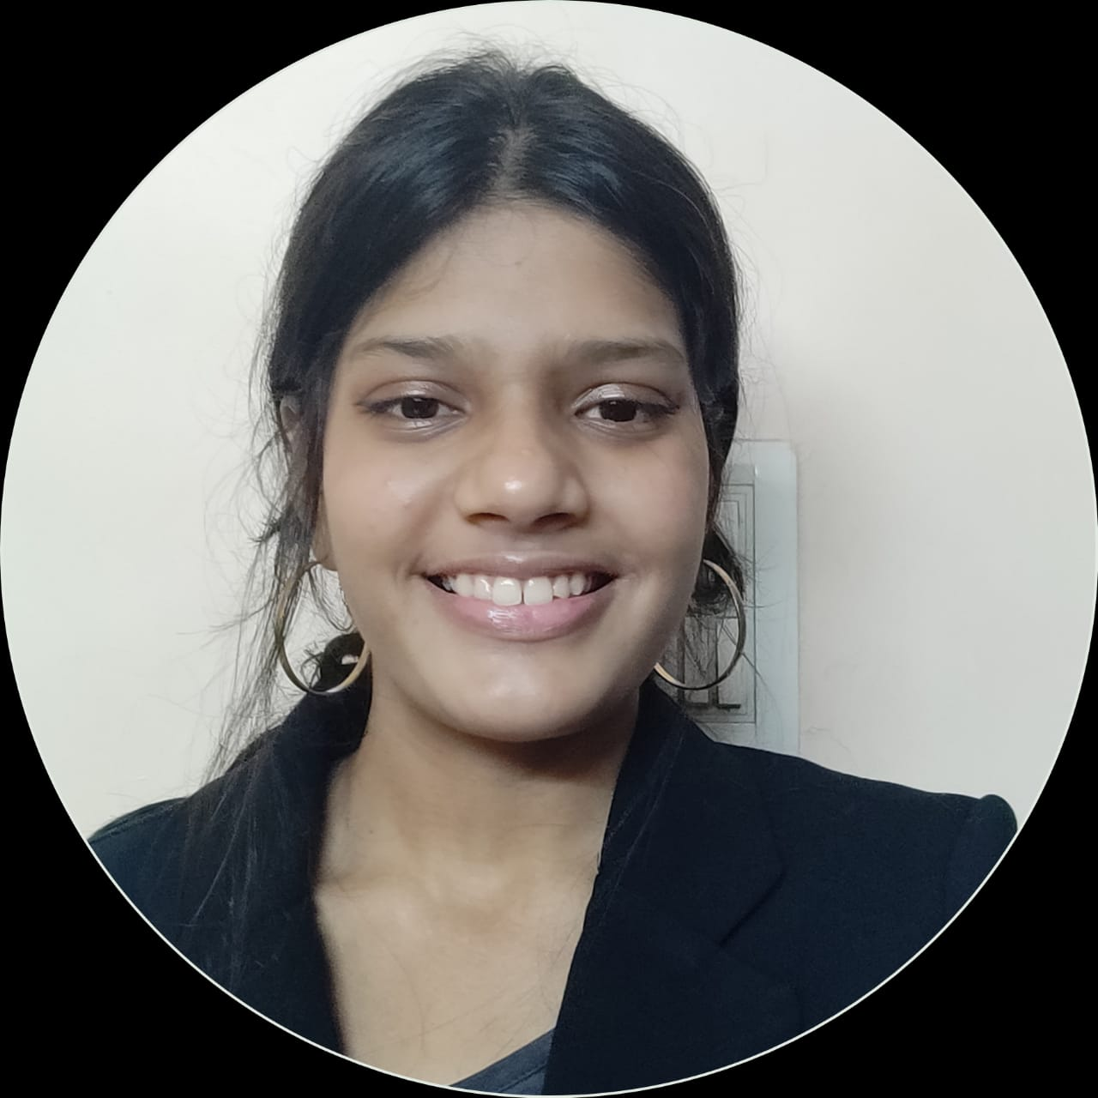
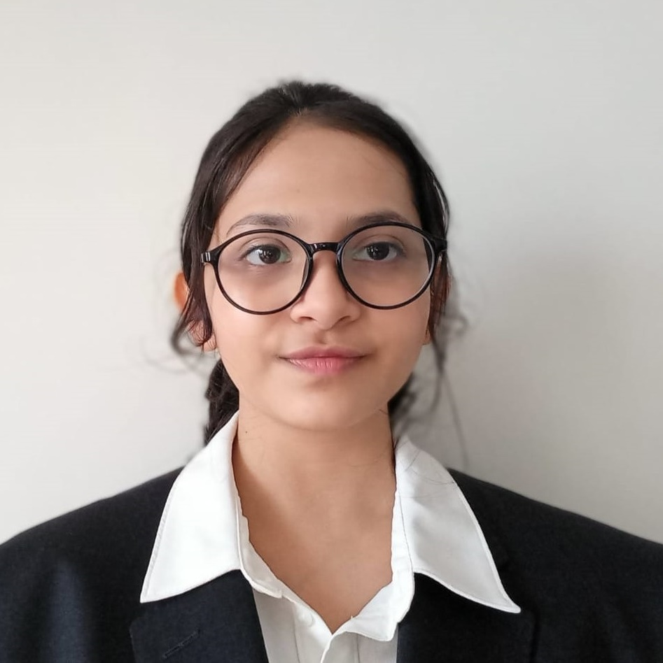
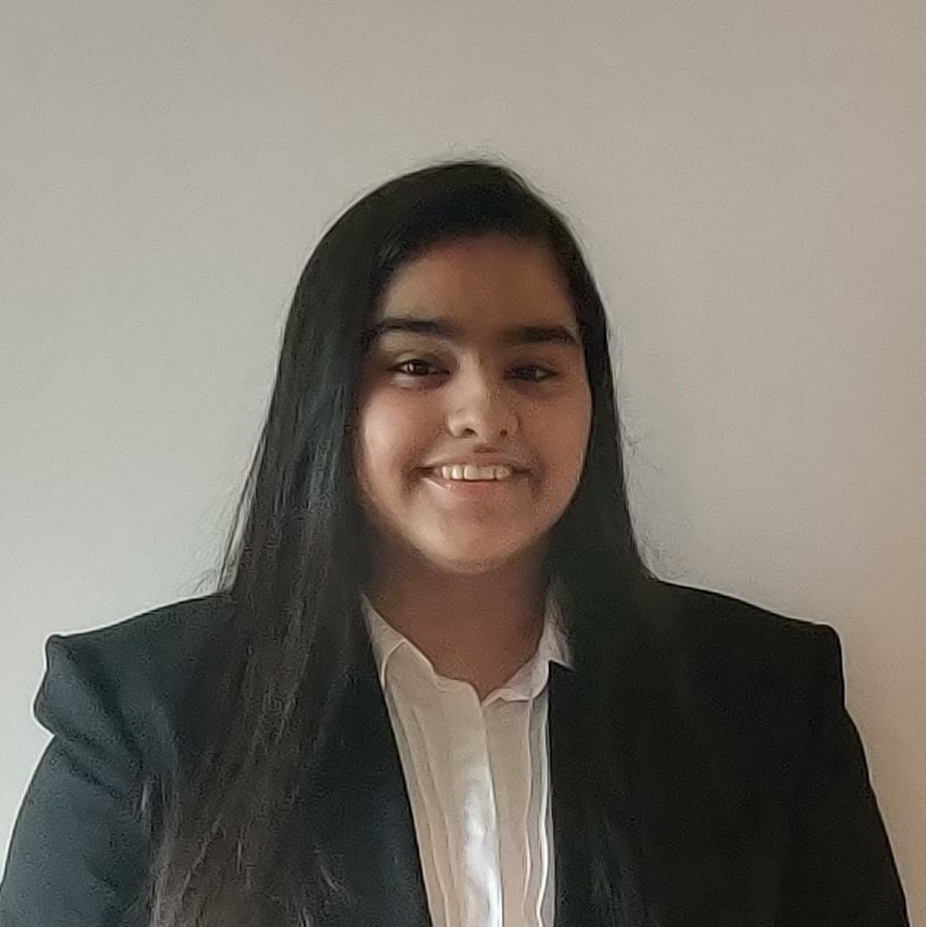
THE TEAM
Aashvi Shah
75252019023
Gargi Rajadnya
75252019019
Vineeta Khanna
75252019010
NOTE: This is the copyright slide of the team

Slide 32
THANK YOU!
Mentored by:
AKASH NAKASHE

